Slide 1
COVID-19 School Staff Training
August 2020

Slide 2
CONTENTS
01
Welcome
02
COVID-19 Background Information
03
Training and Prevention
04
04
Q&A

Slide 3
Welcome
01

Slide 4
We are all in this together

Slide 5
Background on COVID-19
02

Slide 6
COVID-19 Basics
COVID-19 (coronavirus disease 2019) is a new disease, caused by a novel virus that has not previously been identified.
The virus that causes COVID-19 is thought to spread mainly from person to person, through respiratory droplets produced when an affected person, coughs, sneezes, or talks. These droplets can land in the mouths or noses of people who are nearby or possibly inhaled into the lungs. Spread is more likely when people are in close contact with one another (within about 6 feet).

Slide 7
Symptoms of COVID-19
People with these symptoms may have COVID-19:
Fever or chills
Cough
Shortness of breath or difficulty breathing
Fatigue
Muscle or body aches
Headache
New loss of taste or smell

Slide 8
Symptoms of COVID-19 continued
People with these symptoms may have COVID-19:
Sore throat
Congestion or runny nose
Nausea or vomiting
Diarrhea
(this list does not include all the symptoms and may be updated as we learn more about this disease)

Slide 9
Watch for symptoms
Anyone can have mild to severe symptoms. The symptoms of COVID-19 are similar in children and adults; however it can look different in different individuals. People with COVID-19 have had a wide range of reported symptoms-ranging from mild symptoms to severe illness.
Symptoms may appear 2-14 days after exposure to the virus.

Slide 10
Training and Prevention
03

Slide 11
Culture of Health and Safety: Use All Mitigation Strategies
A safe return to in-person school environments will require
developing and maintaining strategies that create a culture
of health and safety every step of the way.
Specifically:
It is not one mitigation strategy but a combination of all these strategies taken together that will substantially reduce the risk of transmission.

Slide 12
Mitigation Strategy #1: Monitor for Symptoms
Staff must monitor themselves for symptoms daily and students, with the assistance of families, must also be monitored daily for symptoms. Staff and students must stay home if feeling unwell for any reason.

Slide 13
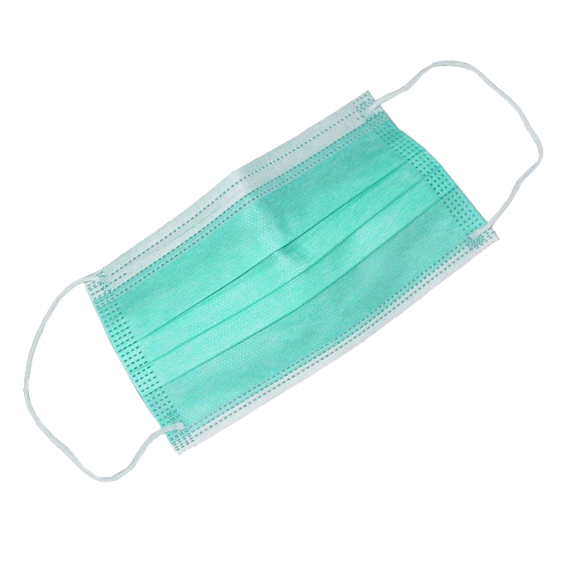
Mitigation Strategy #2: Wear Masks
Masks are among the most important single measures to contain the spread of COVID-19. We require students in second grade and above and all staff to wear masks that adequately cover both their nose and mouth. Whenever possible, students in pre-kindergarten through grade 1 who can safely and appropriately wear, remove, and handle masks should do so.
Mask disposal: If a reusable mask breaks and needs to be thrown out or if a single-use mask needs to be disposed of, it should be placed into the nearest trash can by the individual who wore the mask. The individual should immediately put on a new mask after washing their hands.
This Photo by Unknown Author is licensed under CC BY-NC

Slide 14
Mitigation Strategy #3: Hand Hygiene
Hand hygiene is critical. Students and staff are required to exercise hand hygiene (handwashing or sanitizing) upon arrival to school, before eating, before putting on and taking off masks, and before dismissal. DPH guidance can be located at: https://www.mass.gov/doc/handwashingsanitizer-guidance/download
Handwashing removes pathogens from the surface of the hands. While handwashing with soap and water is the best option, alcohol-based hand sanitizer (at least 60 percent ethanol or at least 70 percent isopropanol) may be utilized when handwashing is not available. CDC. (2020).
Hand Hygiene Recommendations. Available at https://www.cdc.gov/coronavirus/2019-ncov/hcp/hand-hygiene.html

Slide 15
Mitigation Strategy #4: Physical Distancing
Physical distance greatly reduces the risk of transmission. Physical distancing is a critical tool in preventing the spread of COVID-19.

Slide 16
Additional Mitigation Strategies
Cohorts/Assigned Seating
Limit Sharing
Students organized in groups/classrooms and other cohorts help mitigate transmission of the virus. Assigned seating is important because it effectively creates even smaller groups within cohorts which minimize transmission.
Sharing materials is discouraged, but when shared, they must be cleaned before being used by other students.
Melnick, H., & Darling-Hammond, L. (with Leung, M., Yun, C., Schachner, A., Plasencia, S., & Ondrasek, N.). (2020). Reopening schools in the context of COVID-19: Health and safety guidelines from other countries (policy brief). https://learningpolicyinstitute.org/product/reopening-schools-covid-19-brief

Slide 17
Additional Mitigation Strategies: School Cleaning and Disinfecting
Although it is not the main way the virus spreads, it may be possible for an individual to get COVID-19 by touching an object that is contaminated and then touching their own mouth, nose, or possibly eyes. Ensure facilities are properly cleaned and disinfected each day following the guidelines below:
Desks: Desks should be cleaned at least daily. CDC. (2020). Considerations for Schools. Available at https://www.cdc.gov/coronavirus/2019-ncov/community/schools-childcare/schools.html
Electronics: Consider putting a flat, wipeable cover on electronics that are difficult to clean (e.g., keyboards).
Outdoor play areas: High-touch surfaces made of plastic or metal should be cleaned and disinfected at least daily or between use by custodial staff.

Slide 18
Additional Mitigation Strategies: School Cleaning and Disinfecting
Frequency
Responsibility
Cleaning and disinfecting should occur at least daily for shared spaces and furniture. For high-touch surfaces (e.g., door handles, light switches, water fountains, toilet seats) cleaning and disinfecting should occur three to four times per day and/or between uses.
When cleaning surfaces (such as desks, counters, tables, or tray tables, etc.), use a wipe that contains a commercial detergent (e.g., Clorox®, Lysol®, etc), or apply a spray-on detergent (e.g. Formula 409®, Fantastic®, Windex® Multi-Surface, etc.) and vigorously wipe the area that has come into contact with the allergen. https://www.foodallergyawareness.org/food-allergy-and-anaphylaxis/cross-contact/cross-contact/
Dedicated custodial staff should handle all disinfection requiring chemicals for facilities (e.g., classrooms, bathrooms, mask break areas) and high-touch objects (e.g., door handles, light switches, water fountains). For other surfaces, determine cleaning responsibility on a case-by-case basis. For shared and high-touch items such as desks, cleaning responsibility may be shared by students, if the task is age appropriate and safe.

Slide 19
Guidelines for Mealtime
Eating areas for students: As students will be unmasked to eat, there is a strict requirement of 6 feet of physical distance between each student.
Based on current CDC recommendations, it is preferable for students to eat in classroom spaces. This may not be feasible for all sites. Additional information: https://www.cdc.gov/coronavirus/2019-ncov/community/schools-childcare/guidance-for-schools.html

Slide 20
Guidelines for Mealtime
Masks: Ensure proper removal and placement of masks before eating. Masks should be removed by handling the ties or back/ear areas of the mask once seated. Do not touch the outside or inside of the part covering the face. While eating, masks should be placed on a napkin, paper towel, or other container on the table, with the inside of the mask facing up. Masks should be put back on before leaving the seat. More information is available at www.mass.gov/news/mask-up-ma
Distancing: Individuals must be at least 6 feet apart at all times when masks are removed.
Hand hygiene: Individuals must properly wash or sanitize hands before and after eating.

Slide 21
Communication with Families
To support a culture of health and safety, schools must have robust and reliable ways to communicate with all families, students, teachers, and staff in order to send and receive key messages related to COVID-19.
Maintain strong two-way communication with families prior to and throughout the school year incorporating culturally and linguistically responsive practices. Since most students will have spent several months in the full-time company of their family or caregivers, schools and districts should take the opportunity to obtain as much data and information from family or caregivers as possible (e.g., through family surveys, interviews, virtual town halls, etc.).
Districts and schools should ask families directly about the best ways to reach them (download Sample Questions for Individualized Family Communication Plans for example protocols).

Slide 22
If Symptoms Occur and Someone Tests Positive for COVID-19
Self-isolation for COVID-19 positive cases is a minimum of 10 days
Most people who test positive and have a relatively mild illness will need to stay in self-isolation for at least 10 days. People who test positive can resume public activities after 10 days and once they have:
gone for 24 hours without a fever (and without taking fever-reducing medications like Tylenol); and
experienced improvement in other symptoms (for example, their cough has gotten much better); and
received clearance from public health authority contact tracers (the local board of health or Community Tracing Collaborative).

Slide 23
Close Contacts
If someone in the school setting tests positive
If a student or staff member tests positive for COVID-19, their close contacts will be defined as only those who have been within 6 feet of distance of the individual for at least fifteen minutes, while the person was infectious.
The infectious period begins 2 days prior to symptom onset. If someone is asymptomatic, the infectious period is considered to begin 2 days prior to the collection of their positive test. While previous guidance stated that all students in an elementary classroom would be defined as close contacts, this new guidance provides a narrower definition of a close contact which mirrors DPH guidance.

Slide 24
Close Contacts should be tested
Close contacts of a positive COVID-19 case should be tested. For general guidance, DPH defines close contact as:
Being within less than 6 feet of COVID-19 case (someone who has tested positive) for at least 10-15 minutes. Close contact can occur while caring for, living with, visiting, or sharing a healthcare waiting area or room with a COVID-19 case while the case was symptomatic or within the 48 hours before symptom onset, OR
Having direct contact with infectious secretions of a COVID-19 case (e.g., being coughed on) while not wearing recommended personal protective equipment.
https://www.mass.gov/doc/covid-19-testing-guidance/download

Slide 25
Policy for when a close contact may return to school
All close contacts should be tested but must self-quarantine for 14 days after the last exposure to the person who tested positive, regardless of test result. After further consultation with the medical community, we are updating this guidance as the virus can cause illness from 2-14 days after exposure and even asymptomatic individuals can transmit the virus.
Going forward, even if an individual identified as a close contact receives a negative test result, they must continue to self-quarantine for the full 14 days as the virus may take up to 14 days to cause illness.

Slide 26
Scenario: COVID-19-like Symptoms
Policy for when a student/staff person may return to school after COVID-19 symptoms:
If a student or staff member has COVID-19-like symptoms, they may return to school after they have tested negative for COVID-19, have improvement in symptoms, and have been without fever for at least 24 hours without the use of fever reducing medications. If a provider makes an alternative diagnosis for the COVID-19-like symptoms, the individual may return to school based on the recommendations for that alternative diagnosis (e.g., influenza or strep pharyngitis).
If a student or staff member presents COVID-19-like symptoms and chooses not to be tested, they may return to school 10 days from start of symptoms, as long as their symptoms have improved and they have been without fever for at least 24 hours prior to their return to school without the use of fever reducing medication.

Slide 27
Positive Learning Environments: Re-envisioning School Culture and the Conditions for Learning
Establish a strong sense of emotional safety and responsiveness. In the classroom, educators can focus on cultivating a culture of emotional safety and responsiveness, where connection, compassion, and empathy are the first line of support. Build awareness about the range of experiences students may bring into the new school year, how emotions may manifest and implement appropriate support strategies.
Develop a culture and routine that help students integrate in-person and remote learning. Practices that link in-person and remote learning might include synchronous activities led by students (students at school and working remotely join together), weekly check-ins to manage transitions between school- and home-based learning, and regular strategies for connecting with classmates who cannot attend school in person.

Slide 28
Positive Learning Environment: Supporting More Intensive Mental Health Needs
Schools should expect to observe, hear about, and plan for the provision of supports and services to address signs and symptoms of a wide range of mental health challenges that may present during in-person and remote learning.
Identify and utilize research-based Tier 2 and Tier 3 supports and services. Some students will need more sustained, targeted, and intensive supports.
See Examples of Research-Based Processes and Interventions for More Intensive Student Support).

Slide 29
Q&A
04

Slide 30
THANK YOU

